Slide 1


🌞 SolarGuard: Solar Panel Defect Detection
This presentation details SolarGuard, a system for automated solar panel defect detection. We leverage deep learning, specifically VGG16, for classification. The project culminates in an interactive Streamlit application.
by Aishwarya S

Slide 2
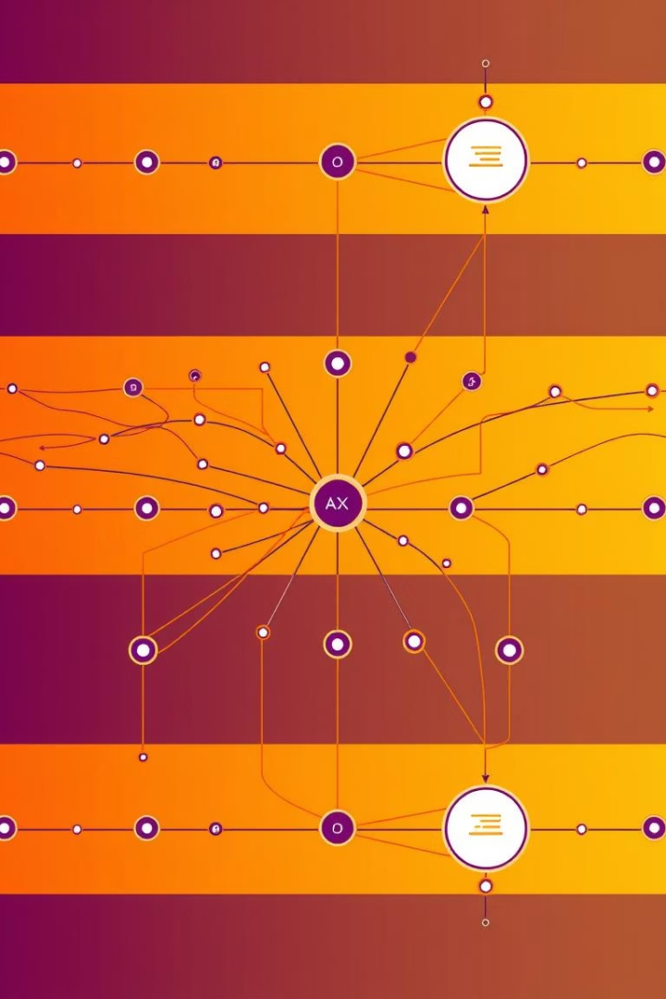



📚 Project Overview
Automated Defect Detection
Using deep learning for efficient identification.
VGG16 CNN Model
Fine-tuned for six-class classification.
Streamlit Web App
Interactive image uploads and predictions.

Slide 3
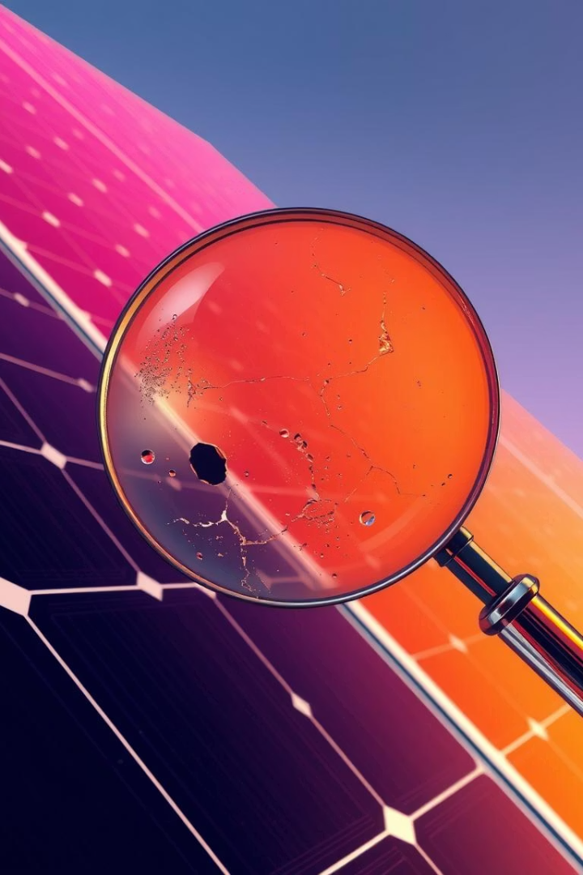




🚀 Key Features
Six-Class Classification
Clean, Dusty, Bird-Drop, Electrical-Damage, Physical-Damage, Snow-Covered.
Data Preprocessing
Enhances model performance and generalization.
Evaluation Metrics
Confusion matrix and detailed classification report.
Streamlit Application
User-friendly interface for predictions.

Slide 4

📂 Dataset Structure
/Project_Solar_Panel/
Defect Categories
/Clean/
/Electrical-Damage/
/Dusty/
/Physical-Damage/
/Bird-Drop/
/Snow-Covered/
The dataset is organized into distinct directories for each defect class. This structure facilitates effective training and validation of the classification model.

Slide 5
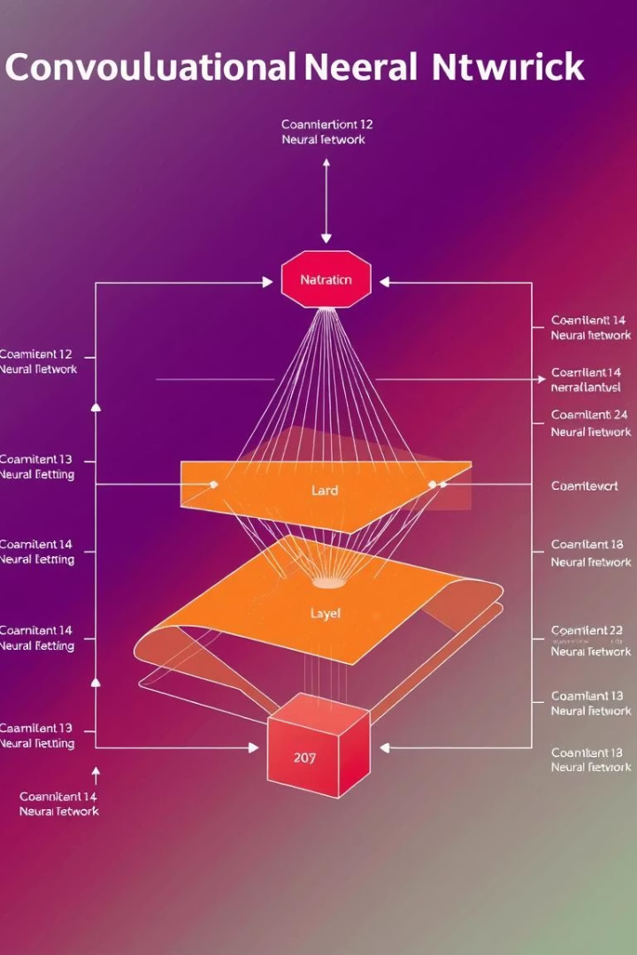




📈 Model Overview
Base Model
Input Format
Output Layer
VGG16, pre-trained on ImageNet for robust feature extraction.
224x224 RGB images.
Six distinct defect classes.
Optimizer
Adam, for efficient gradient descent.
The model leverages VGG16's powerful feature learning. It's fine-tuned with specific parameters for solar panel defect detection.

Slide 6
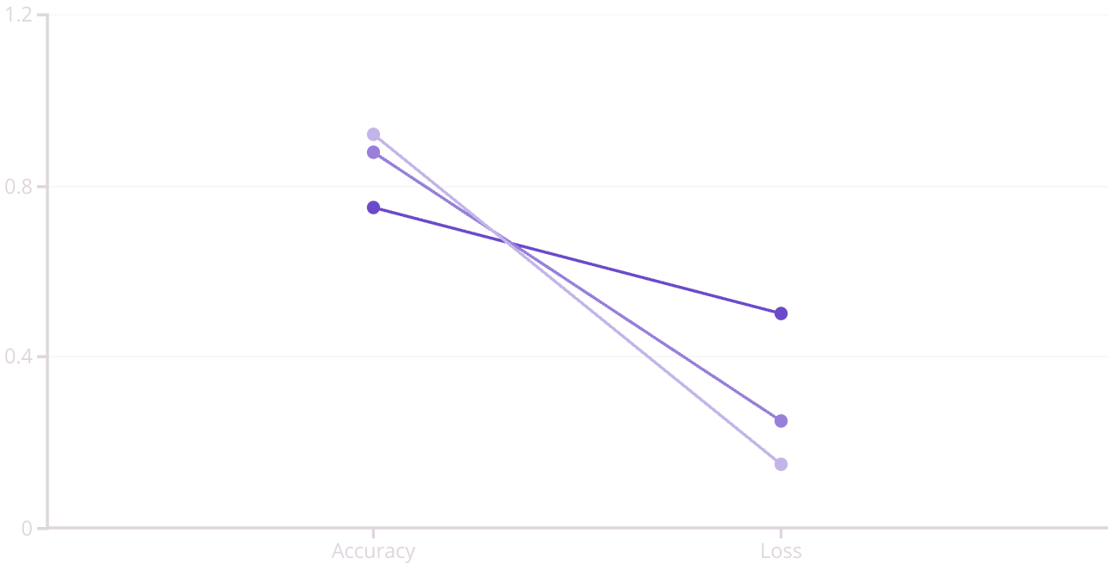
📊 Training Results
Epoch 1
Epoch 5
Epoch 10
The model demonstrated strong learning. Accuracy consistently improved. Loss values decreased steadily, indicating effective optimization. A confusion matrix shows classification performance per class.

Slide 7
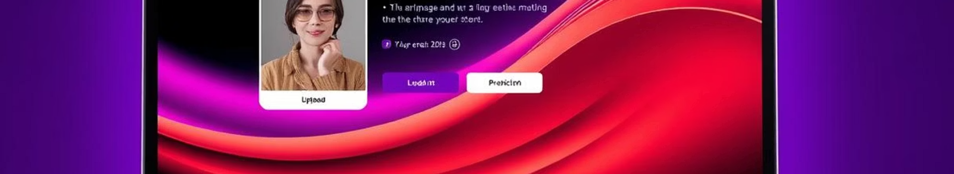
💻 Streamlit App
Get Predictions
Upload Images
Receive instant classification results.
Run Locally
Easily select solar panel images from your device.
Use streamlit run app.py in your terminal.
The Streamlit application provides a practical interface. It allows users to quickly test the model. This makes defect detection accessible and efficient.

